Slide 1

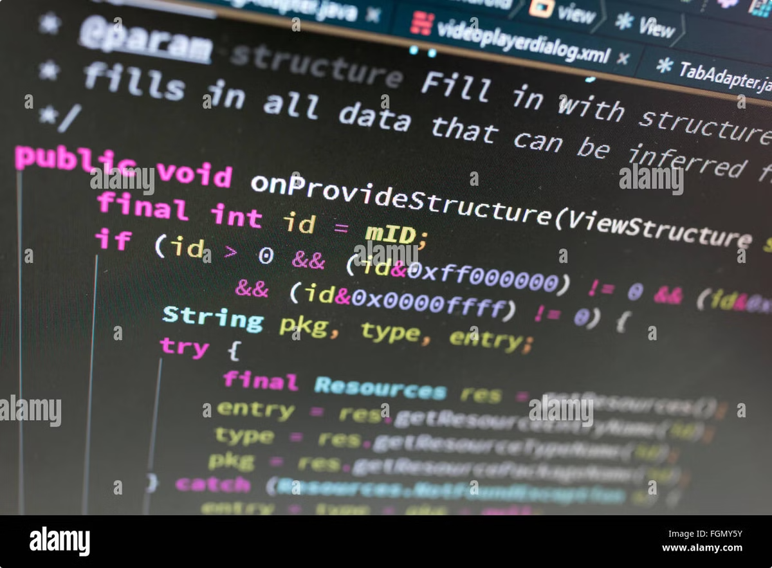

Translators: The Language Bridge
Translators are essential tools for software development, acting as bridges between human-readable code and the language computers understand. They enable programmers to write instructions in high-level languages, which are then converted into low-level machine code.
by Istiak Rahman

Slide 2


Translators: The Power of Translation
Translators are essential tools in programming. They connect our way of thinking about problems with how computers process instructions. By understanding different types of translators, we can choose the best tool for each programming task and appreciate the importance of translation in software development.

Slide 3
Assemblers: Close to the Hardware
Assembly Language
Assembler's Role
Example
Assembly language is a low-level language that uses symbolic codes to represent machine instructions. It's directly related to the computer's architecture and gives you complete control over the hardware.
An assembler converts assembly language into machine code by changing each symbolic instruction into its binary form. This process is quick because assembly language is already similar to machine code.
Here's a simple assembly code snippet:
MOV AX, 1 ; Move 1 into register AX ADD AX, 2 ; Add 2 to the value in AX
The assembler translates this into binary machine code for the processor.

Slide 4


Compilers: Building for Speed
1
Source Code
The compiler takes high-level language code, like C, C++, or Java, as input. It analyzes the entire program to understand its structure and logic.
2
Translation
The compiler converts the entire program into machine code , which is a set of instructions that can be directly executed by the computer's processor.
3
Executable Program
Once compiled, the program can be run multiple times without recompiling. Compiled programs are generally faster because they are translated only once and are optimized for the hardware..

Slide 5





Interpreters: Line-by-Line Execution
Code Input
Interpreters take high-level language code, such as Python, JavaScript, or Ruby, as input. They process the code line-by-line.
Line-by-Line Translation
For each line of code, the interpreter translates it into machine code and executes it immediately, without compiling the entire program beforehand.
Output
This process continues for each line of code, resulting in the program's execution. Interpreted programs run slower than compiled ones because the translation process occurs during execution.

Slide 6
Comparison: Assemblers, Compilers, and Interpreters
Feature
Assembler
Compiler
Interpreter
Input Language
Assembly Language
High-level Language
High-level Language
Output Language
Machine Code
Machine Code or Bytecode
Executes directly (no output code)
Translation Method
Line-by-line translation
Translates entire program at once
Translates and executes line-by-line
Speed of Execution
Very fast
Fast after compilation
Slow, as it interprets line-by-line
Error Reporting
After entire assembly
After entire compilation
Immediately, line-by-line
Storage of Result
Stores machine code for later use
Stores compiled machine code
No intermediate storage; executes immediately
Example Languages
Assembly
C, C++, Java
Python, JavaScript, Ruby

Slide 7

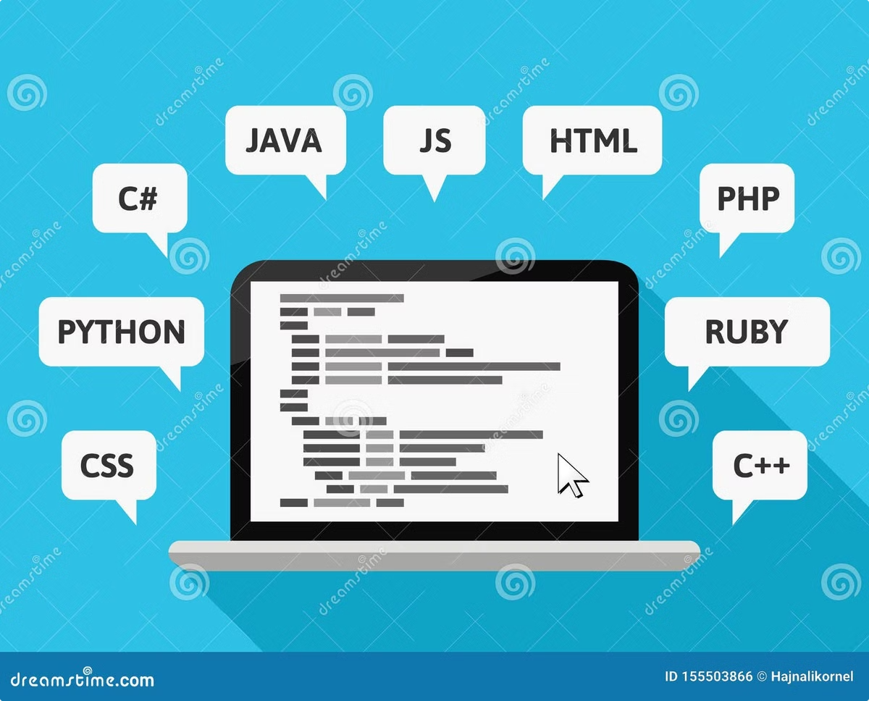
Translators in Action
1
Assembler
Assemblers are used for low-level programming tasks, such as device drivers and embedded systems, where direct hardware manipulation is required.
2
Compiler
Compilers are essential for systems programming (operating systems, databases), game development, and performance-critical applications where speed is crucial.
3
Interpreter
Interpreters are popular in web development (JavaScript), scripting (Python, Ruby), and rapid prototyping, where ease of debugging and quick iteration are important.

Slide 8

Thank You!
Presented by: Istiak Rahman
Email: istiak.rahman1020@gmail.com
Thank you for your attention! I appreciate your time and interest.
Keep Learning, Keep Growing

